Slide 1
\
A Book is a Dream You Hold in Your Hands
-Neil Gaiman

Slide 2
Reading Calendar
Notes:
-------------
-------------
-------------
-------------
-------------
S | M | T | W | Th | F | Sa

Slide 3
A Book is a Dream You Hold in Your Hands
-Neil Gaiman

Slide 4
Reading Calendar
Notes:
-------------
-------------
-------------
-------------
-------------
S | M | T | W | Th | F | Sa

Slide 5
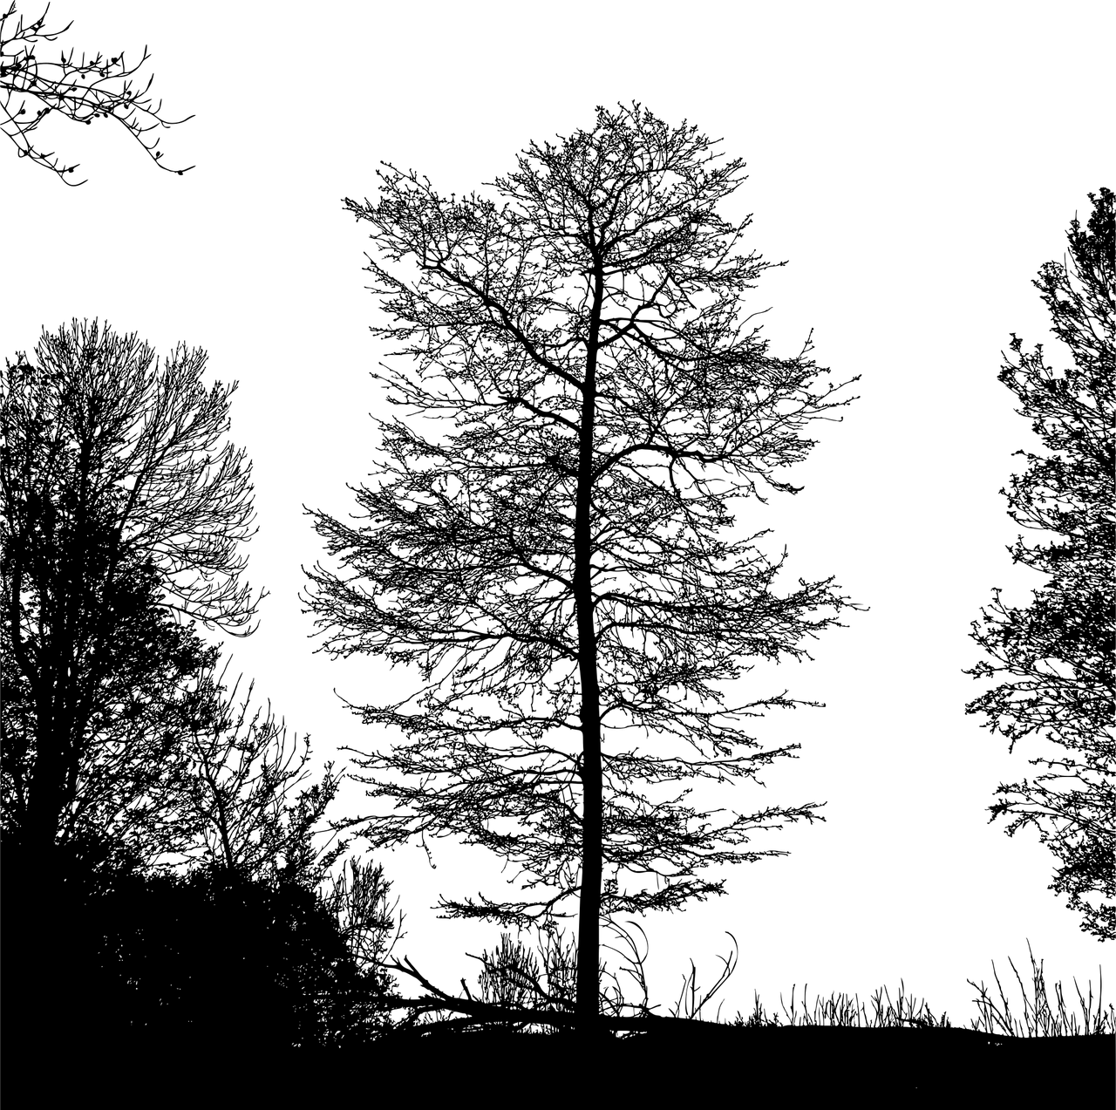
“Books are uniquely portable Magic”
– Stephan King

Slide 6
Reading Calendar
Notes:
-------------
-------------
-------------
-------------
-------------
S | M | T | W | Th | F | Sa

Slide 7

The Past is
Full of Whimsical
Happenings

Slide 8
Reading Calendar
Notes:
-------------
-------------
-------------
-------------
-------------
S | M | T | W | Th | F | Sa

Slide 9
Between the pages of a book
is a
lovely place to be

Slide 10
Reading Calendar
Notes:
-------------
-------------
-------------
-------------
-------------
S | M | T | W | Th | F | Sa

Slide 11
Between the pages of a book
is a
lovely place to be

Slide 12
Reading Calendar
Notes:
-------------
-------------
-------------
-------------
-------------
S | M | T | W | Th | F | Sa

Slide 13
Just one more page..

Slide 15
Just one more page..

Slide 17
Just one more page..

Slide 19

It’s a great day to read a book

Slide 20
Reading Calendar
Notes:
-------------
-------------
-------------
-------------
-------------
S | M | T | W | Th | F | Sa

Slide 21
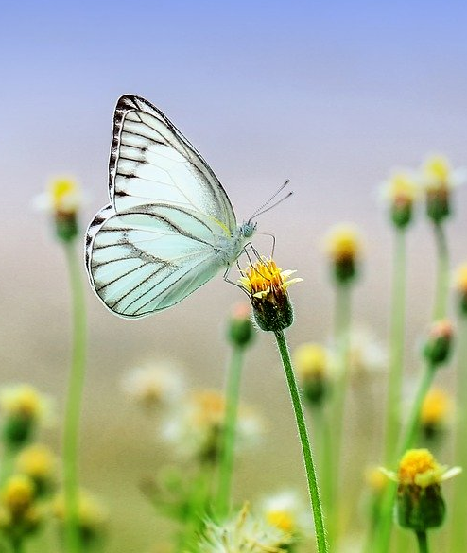
It’s a great day to read a book

Slide 22
Reading Calendar
Notes:
-------------
-------------
-------------
-------------
-------------
S | M | T | W | Th | F | Sa

Slide 23

It’s a great day to read a book

Slide 24
Reading Calendar
Notes:
-------------
-------------
-------------
-------------
-------------
S | M | T | W | Th | F | Sa

Slide 25
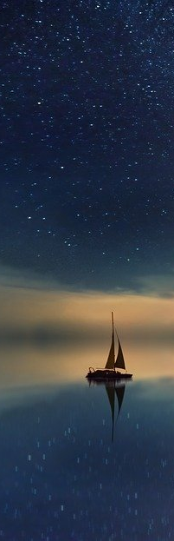
Get lost in a good book

Slide 26
Reading Calendar
Notes:
-------------
-------------
-------------
-------------
-------------
S | M | T | W | Th | F | Sa

Slide 27

Get lost in a good book

Slide 28
Reading Calendar
Notes:
-------------
-------------
-------------
-------------
-------------
S | M | T | W | Th | F | Sa

Slide 29
Fiction reveals truths that reality obscures.
– Ralph Waldo Emerson

Slide 31
Fiction reveals truths that reality obscures.
– Ralph Waldo Emerson

Slide 33
Fiction reveals truths that reality obscures.
– Ralph Waldo Emerson

Slide 35
Fiction reveals truths that reality obscures.
– Ralph Waldo Emerson

Slide 37


1990’s VIBES

Slide 38
Reading Calendar
Notes:
-------------
-------------
-------------
-------------
-------------
S | M | T | W | Th | F | Sa

Slide 39
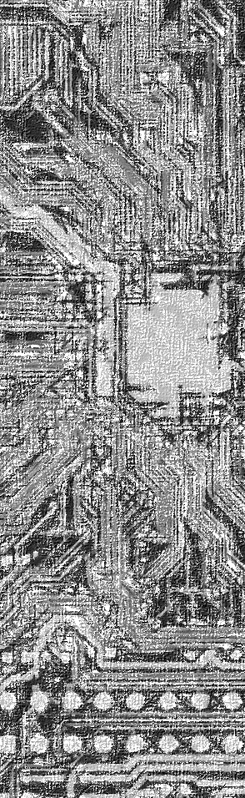

Slide 40
Reading Calendar
Notes:
-------------
-------------
-------------
-------------
-------------
S | M | T | W | Th | F | Sa

Slide 41
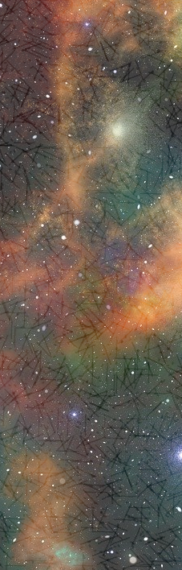

Slide 42
Reading Calendar
Notes:
-------------
-------------
-------------
-------------
-------------
S | M | T | W | Th | F | Sa

